Slide 1


Microservices and Containers
Hugo Melendez
Technical Solution Professional

Slide 2
Session objectives and takeaways
Learn more about microservice-based architecture (MSA), and its pros and cons
Learn about deploying microservices on Azure using ACI, AKS and Service Fabric.

Slide 3
What are microservices?

Slide 4
What are micro services?
An approach to application development in which a large solution is built as a suite of modular services
Each service supports a specific business goal and uses a simple well-defined interface to communicate
Each service is isolated, has its own dependencies, domain and logic, and evolves independently
Embracing cross-platform, each can be written in a different programming language, use different data storage technologies, and scale independently
There is starting to be a consensus that a micro service is a ‘simple application’ that is around the 10–100 LOC mark

Slide 5
Micro service architecture
Refactoring a monolith to a micro service-based architecture
Product
Cart
Pricing
User interface
Functional application areas decomposed into isolated service
P
C
P
Business logic
C
CLIENT APP
P
C
P
P
P
Each micro services maintains state and stores data
Data access
P
C
P
Relational
Doc
Name/
value
Database
MONOLITHIC APP

Slide 6

Microservices != SOA
SOA and Microservices share similarities, but are different…
Microservices embrace light-weight open-source technologies such as REST
Microservices tend to be much smaller
Microservices are independently deployable
Microservices embrace decentralized data stores
Notes:
Service-oriented architecture. A service-oriented architecture (SOA) is a style of software design where services are provided to the other components by application components, through a communication protocol over a network. The basic principles of service-oriented architecture are independent of vendors, products and technologies.
Microservices, aka Microservice Architecture, is an architectural style that structures an application as a collection of small autonomous services, modeled around a business domain.

Slide 7
Microservices != Containers
Microservice Isolated application with a single purpose
Container Encapsulate discrete components of app logic and the corresponding runtime
Containers are used frequently to host microservices
Provide fine-grained execution environment
Provide a high degree of isolation
Provide fast initialization and execution
Provide to provision and manage microservice-based apps

Slide 8
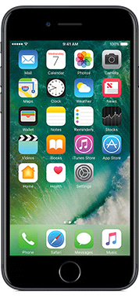
Microservices architecture—detail view
Http Request/Response
Async Pub/Sub
Product Catalog
Admin
Microservice
User
Shopping Basket
Web
API Gateway
Microservice
Microservice
User
Event Grid / Service Bus
User
Admin
Inventory
Microservice
User
Ordering
User
Microservice

Slide 9
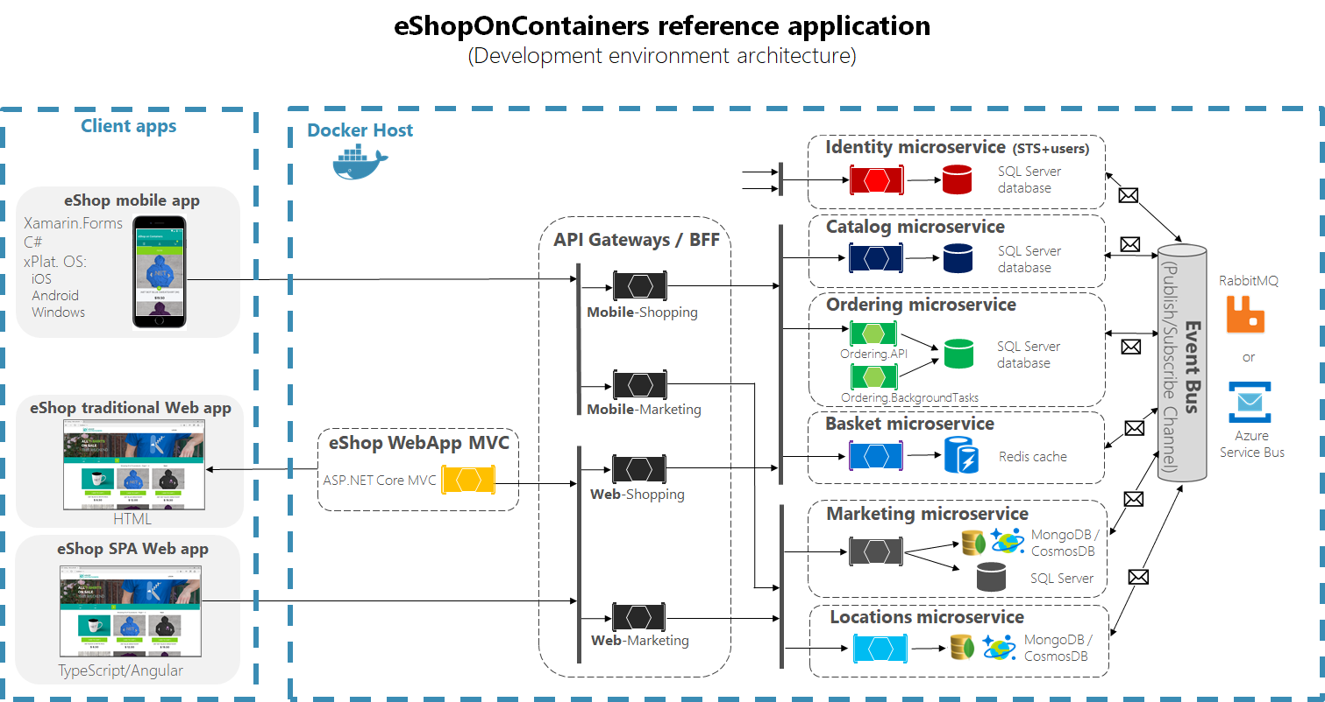
eShop on Containers Example

Slide 10
Microservices: Benefits
Encapsulates business functionality into small targeted services, organized around business capabilities
Services deploy frequently and evolve independently
Services scale Independently
Enables technology diversity
Mix multiple programming platforms and data-storage technologies—best tool for the job
Rewriting/modernizing a single service is feasible
“Future-proofs” application investment against obsolete technology stacks
Failure in one service less likely to cause system-wide failure

Slide 11
Microservices: Challenges
No free lunch…
Architectural and operational complexity increase
Remote calls escalate network I/O, congestion and latency
Distributed services expose points of failure, reducing reliability
Decentralized data require eventual consistency delays
Integration and versioning concerns become critical
Service discovery and routing concerns must be handled
Testing—stubs/mocks become key
Orchestration, management, and monitoring are mandatory

Slide 12
Microservice candidates
Most solutions do not warrant a microservices architecture
Consider microservices, when…
Large, strategic enterprise systems that need to align business capabilities/features
Systems that require a high release velocity: Frequent feature releases with high confidence
Applications developed by heterogenous teams with expertise in different technology stacks – Polyglot languages and tools
Application with components that must scale independently

Slide 13
Containers

Slide 14
Virtualization versus containerization
Virtual machine
Container
Application XYZ
Application
App dependencies
Dependencies
Guest OS
C
C
C
C
C
VM
VM
VM
VM
VM
VM
Dependency 1
Dependency 2
Hypervisor 2
Docker Engine
Hypervisor 1
Host OS
Host OS
Hardware
Hardware
Hardware
Type 1
Type 2
Virtualization
Containerization

Slide 15
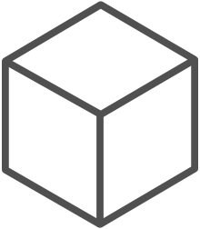
The container advantage
Fast iteration
Agile delivery
Immutability
Cost savings
Efficient deployment
Elastic bursting
For developers
For IT

Slide 16
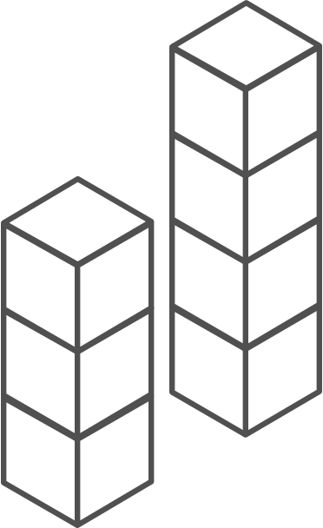
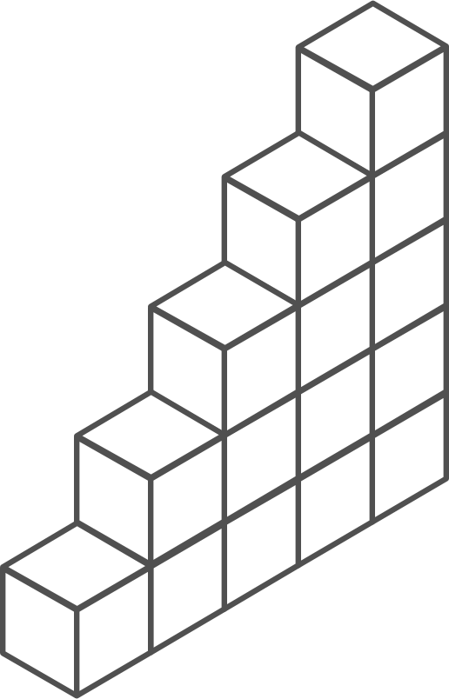
Containers are gaining momentum
Does your organization currently use container technologies?¹
23%
My org. is evaluating container technologies
Yes, my org. currently uses container technologies
No, my org. is not using container technologies
Not sure
Not applicable
Larger companies are leading adoption.²
42%
~60%
25%
7%
Nearly 60% percent of organizations running 500 or more hosts are classiﬁed as container dabblers or adopters.
2%
The average company QUINTUPLES its container usage within 9 months.¹
Container hosts often run SEVEN containers at a time.¹
Containers churn 9 times FASTER than VMs.¹
5x
7x
9x
Source:
1: Datadog: 8 Surprising Facts About Real Docker Adoption; 2: DZone: The DZone Guide to Deploying and Orchestrating Containers

Slide 17
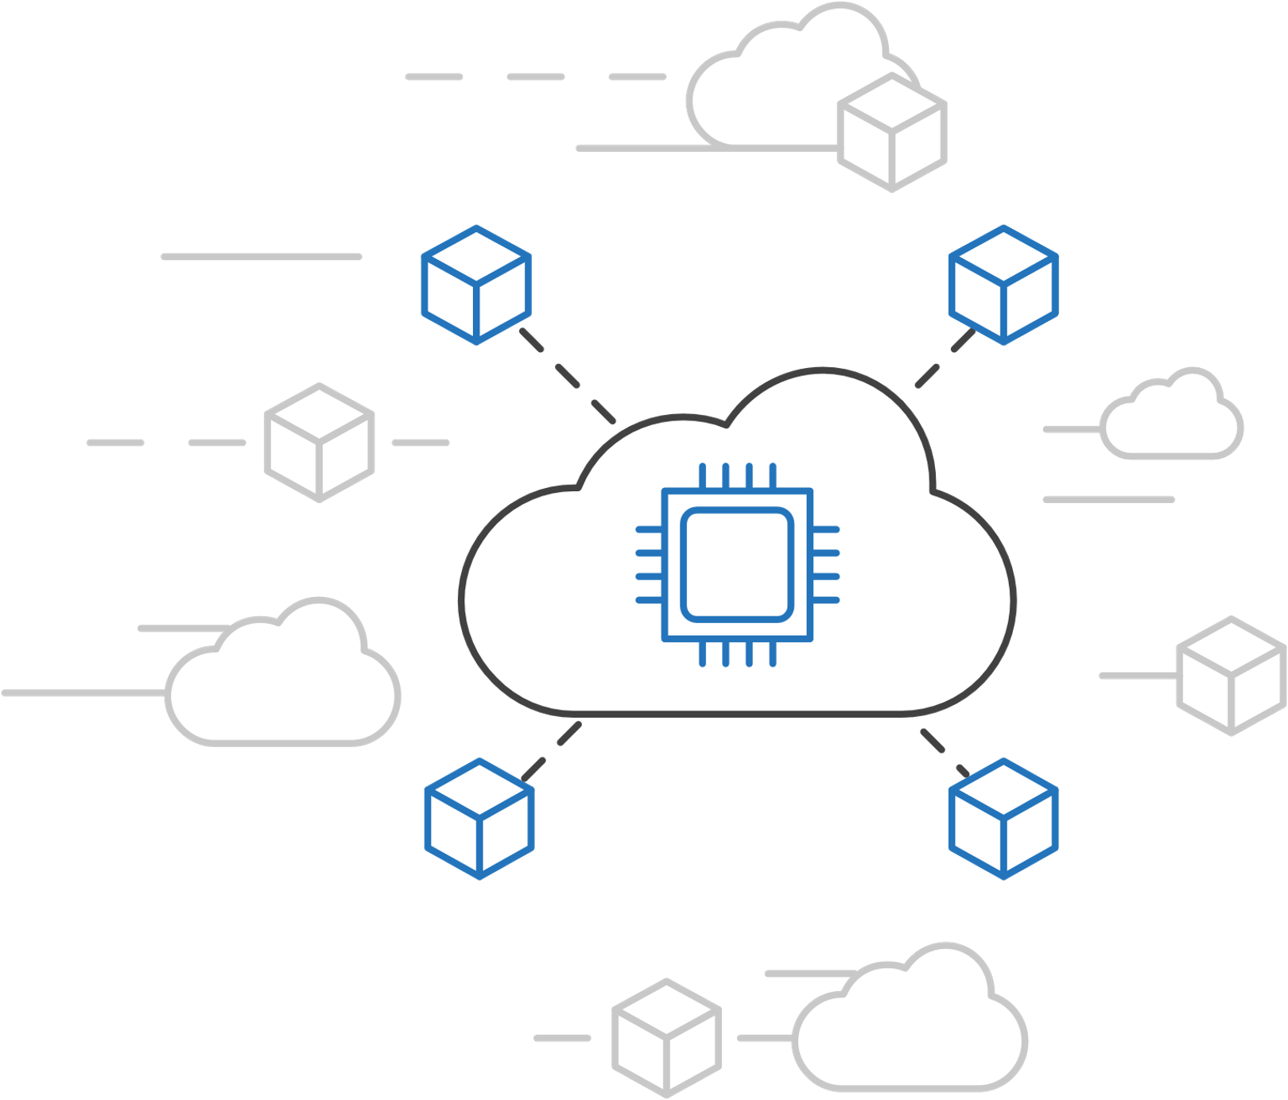
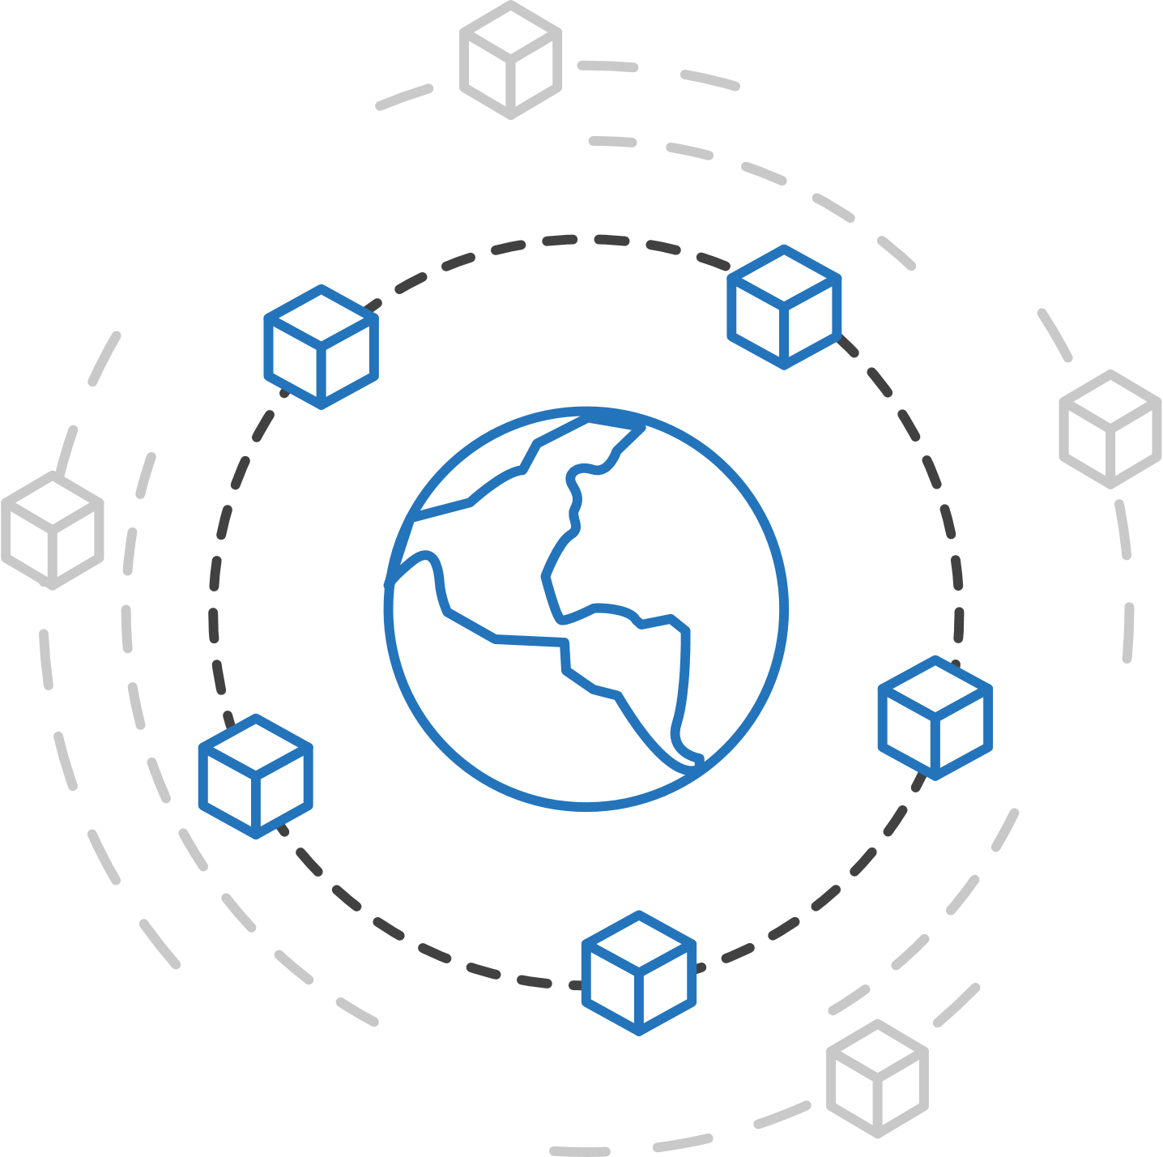
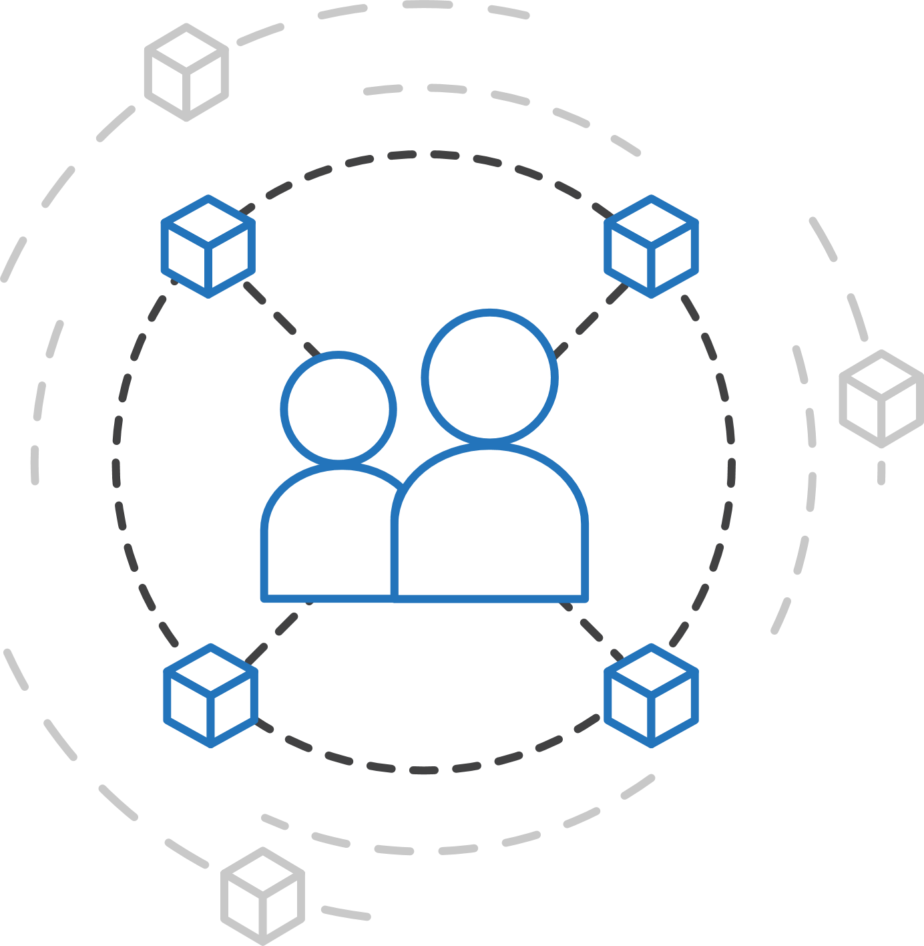
Azure container strategy
Embrace containers as ubiquitous
Support containers across the compute portfolio
Democratize container technology

Slide 18

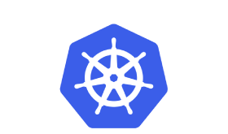
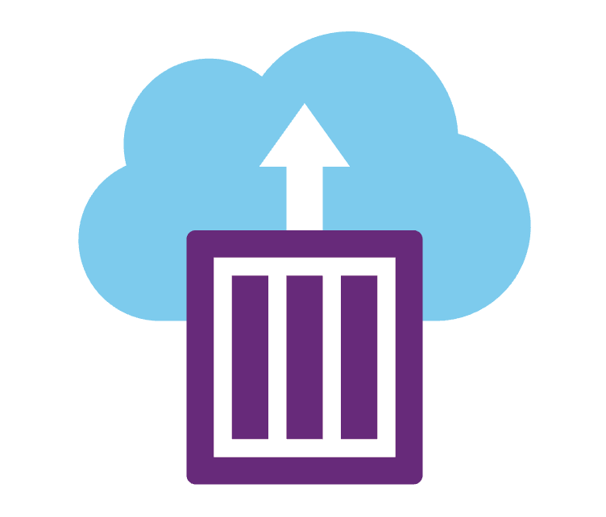
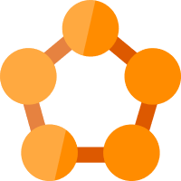

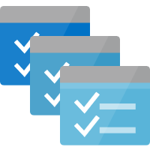
Deploy containers everywhere in Azure
ACI
AKS
Service Fabric
Web Apps
Batch

Slide 19
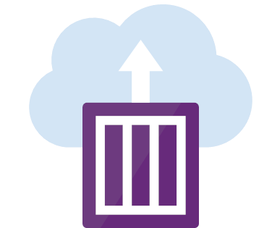
Azure Container Instances (ACI)
Easily deploy and run containers with a single command
Launch container instances in seconds
Cost effective per second billing
Notes:
https://docs.microsoft.com/en-us/azure/container-instances/container-instances-quickstart

Slide 20
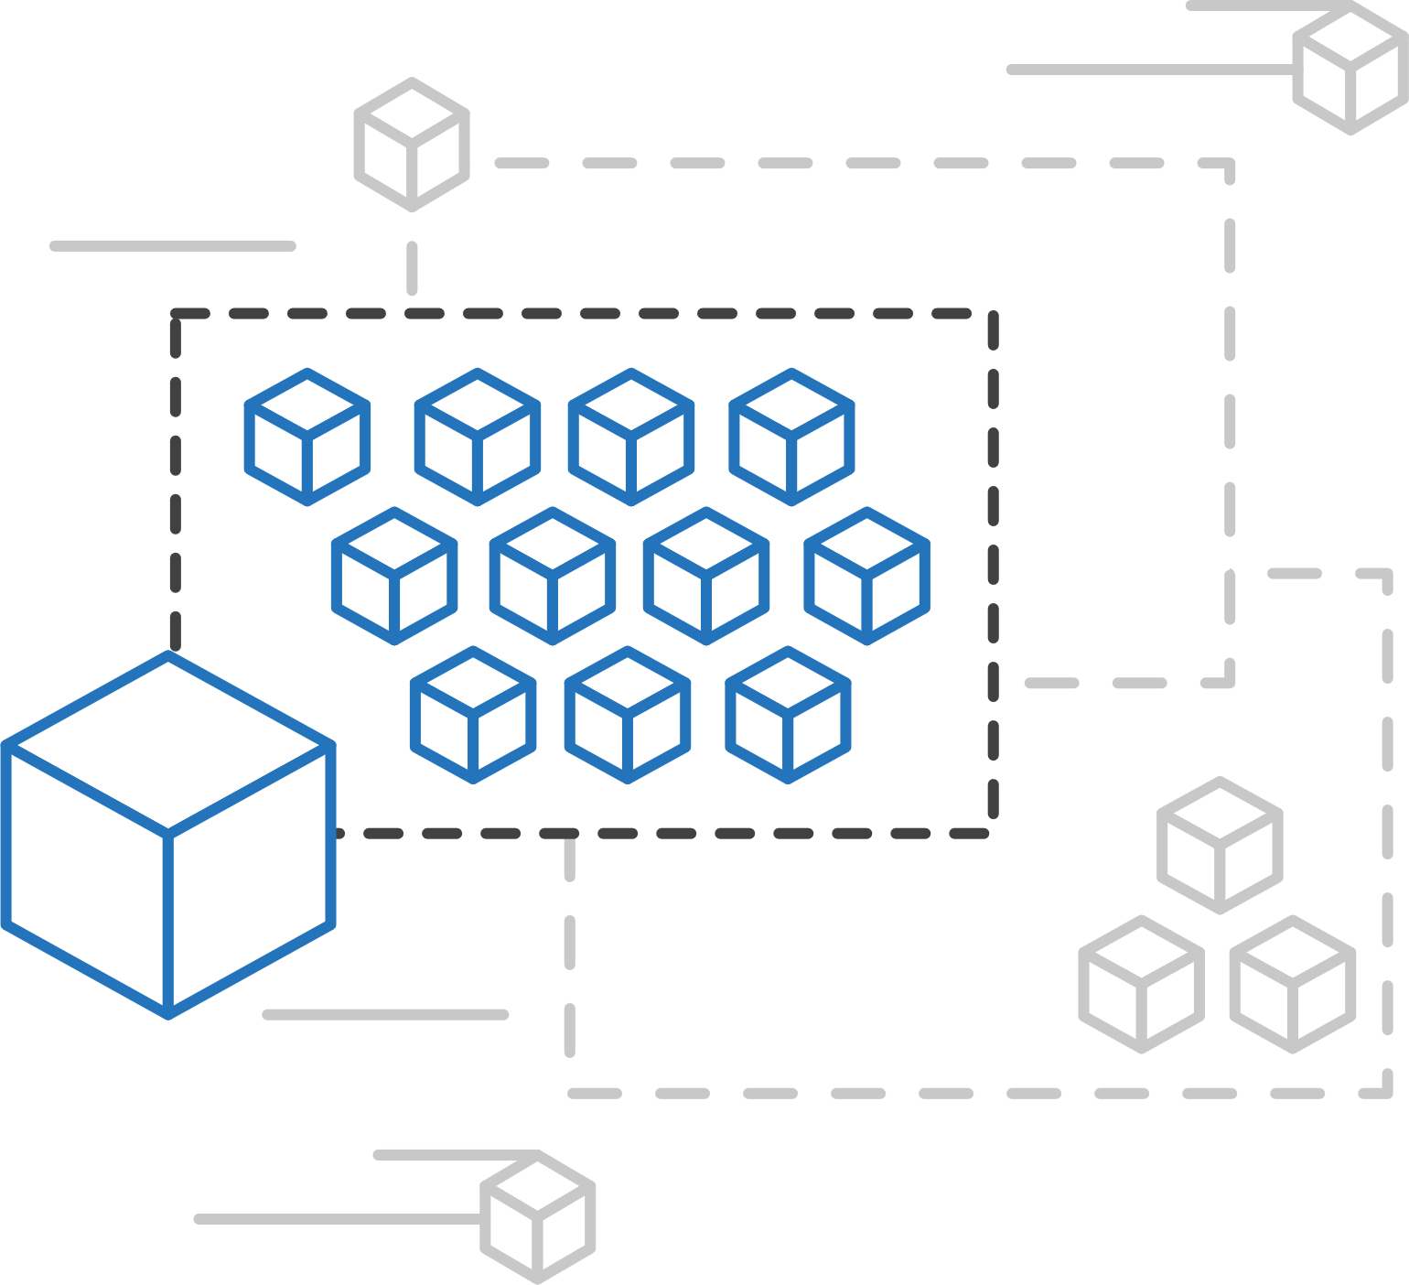
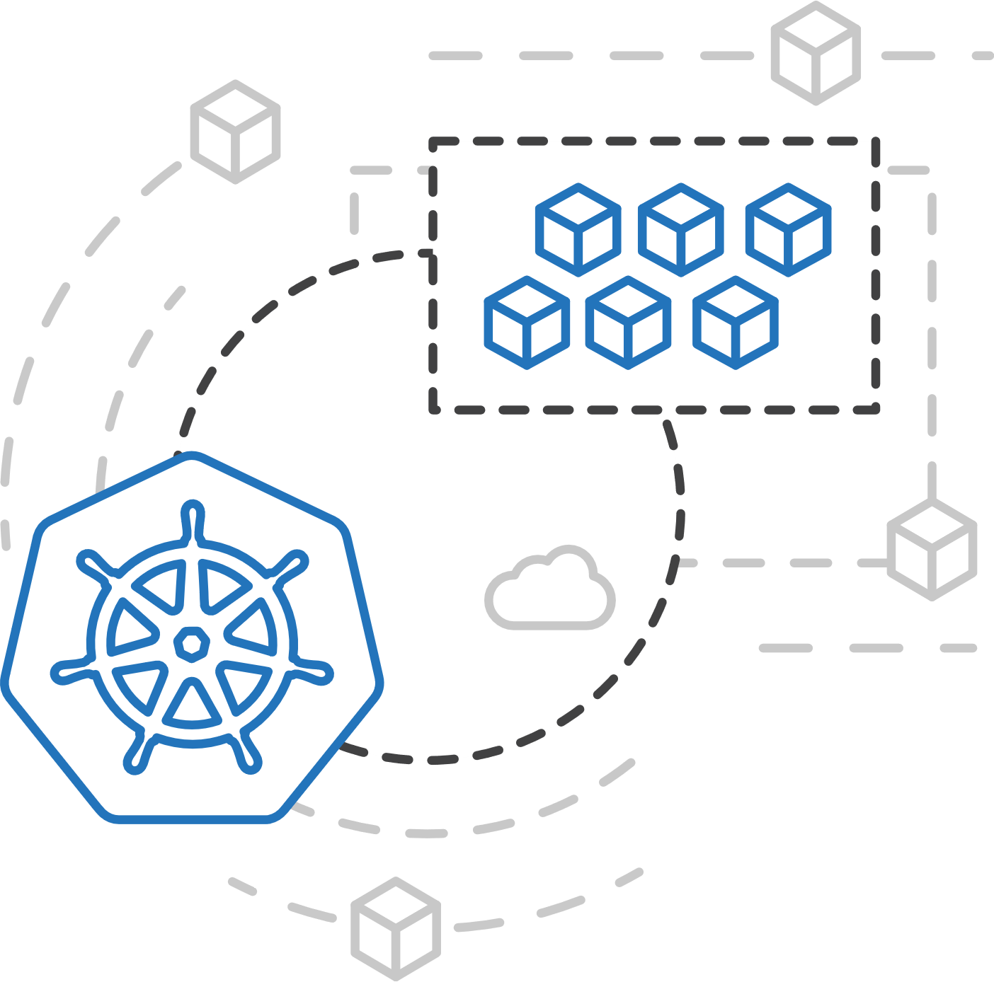
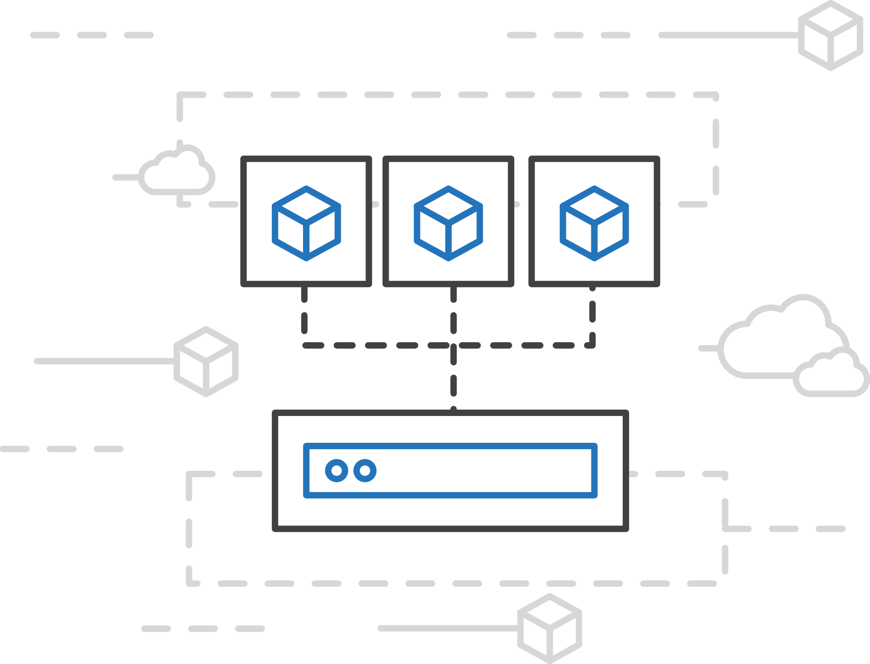
Azure Container Instances (ACI)
Easily run containers on demand without managing servers
Run containers without managing servers
Increase infrastructure agility with containers on demand
Secure applications with hypervisor isolation

Slide 21
No infrastructure to manage
Fast start and stop
Fast scale without VM start-up

Slide 22


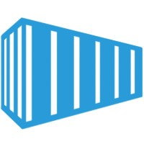
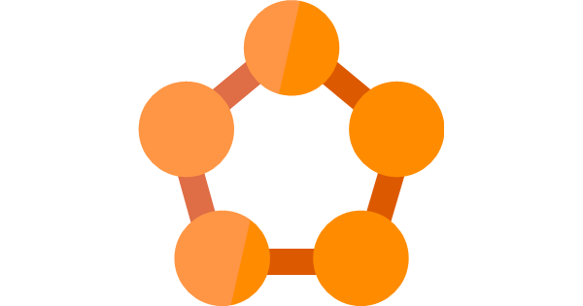
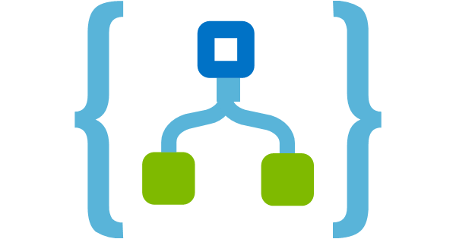

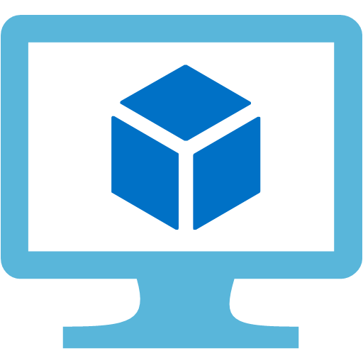



Twitter
Web front-end
(Web Forms)
Tweets DB
(Cosmos DB)
Twitter to Cosmos
(LogicApps)
Demo
Service tier
(WCF)
Listener (Stateless service)
Sentiment Analysis
Lift and Shift
Cloud Optimized
App Modernized
Data tier
(SQL VM)
Database
(SQL DB)
Database
(SQL Azure)
Database
(SQL Azure)
Notes:
Demo creating ACI instance and deploying helloworld image

Slide 23

Azure Container Service (AKS)
Fully managed Kubernetes orchestration service
Auto patching, auto scaling, auto updates
Use the full Kubernetes ecosystem (100% upstream)
Deeply integrated with Azure Dev Tools and services

Slide 24
Twitter
Web front-end
(Web Forms)
Tweets DB
(Cosmos DB)
Twitter to Cosmos
(LogicApps)
Demo
Service tier
(WCF)
Listener (Stateless service)
Sentiment Analysis
Lift and Shift
Cloud Optimized
App Modernized
Data tier
(SQL VM)
Database
(SQL DB)
Database
(SQL Azure)
Database
(SQL Azure)
Notes:
Show how quickly AKS cluster can be created using Azure Portal
Show Quick Start Demo on Deploying a service o

Slide 25
Service Fabric
Windows and Linux Containers
Stateless and stateful microservices
Deploy on Azure, Azure Stack and on-premises

Slide 26
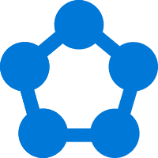

Build once and run everywhere
Dev machine
Any cloud
On-premises
Service Fabric Dedicated Cluster
Service Fabric
Mesh
Service Fabric Standalone
Dedicated Azure clusters
Fully managed by Azure
Bring your own infrastructure

Slide 27





Azure Service Fabric Mesh
A fully managed microservices platform for business-critical applications
Focused microservices development
Fully-managed infrastructure
Elastic scalability
</>
.NET
</>

Slide 28
Twitter
Web front-end
(Web Forms)
Tweets DB
(Cosmos DB)
Twitter to Cosmos
(LogicApps)
Demo
Service tier
(WCF)
Listener (Stateless service)
Sentiment Analysis
Lift and Shift
Cloud Optimized
App Modernized
Data tier
(SQL VM)
Database
(SQL DB)
Database
(SQL Azure)
Database
(SQL Azure)
Notes:
Demo SfB Mesh

Slide 29

Great Partner Solutions
DC/OS
Pivotal
OpenShift
Docker Enterprise

Slide 30
Resources
Choosing the right Azure Compute Service Brendan Burns Designing Distributed Systems eBook
.NET Microservices eBook
Container / microservice examples / source code

Slide 31
Questions?

Slide 32
Thank you!

